Slide 1


Slide 2


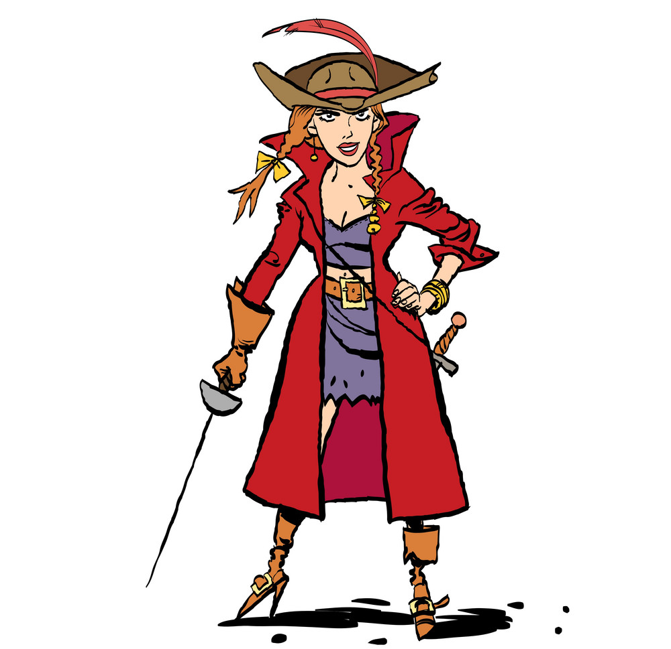

Slide 4

“Arrr! Remember it’s easiest if you imagine the paths you want to walk!”

Slide 5
The captain will show you the gold coins twice: once slowly, once more quickly.
After you walked to these gold coins several times, the captain will hide them at different locations.
Tips:
Visualise which paths you want to walk on while you can see the gold coins.
You will be rewarded more if you always use the same paths.
Press 1 to start!

Slide 6


Slide 8
Ahoy, ye scallywag! New gold coins be rollin’ in!

Slide 10



